Slide 1

Data Preprocessing
Introduction to Deep Learning (11-485/685/785)
Notes:
Hi everyone! My name is Yonas, I am one of your TAs for the course intro to deep learning for the spring semester. In this recitation, we will go through data preprocessing which is one of the most important steps to building accurate models in deep learning and generally in machine learning.

Slide 2
Topics
Introduction
Importance of Preprocessing
Reasons for Preprocessing
Techniques for Preprocessing
Tools for Preprocessing
Preprocessing Speech Data
Extracting Mel-Frequency Cepstral Coefficients (MFCCs)

Slide 3
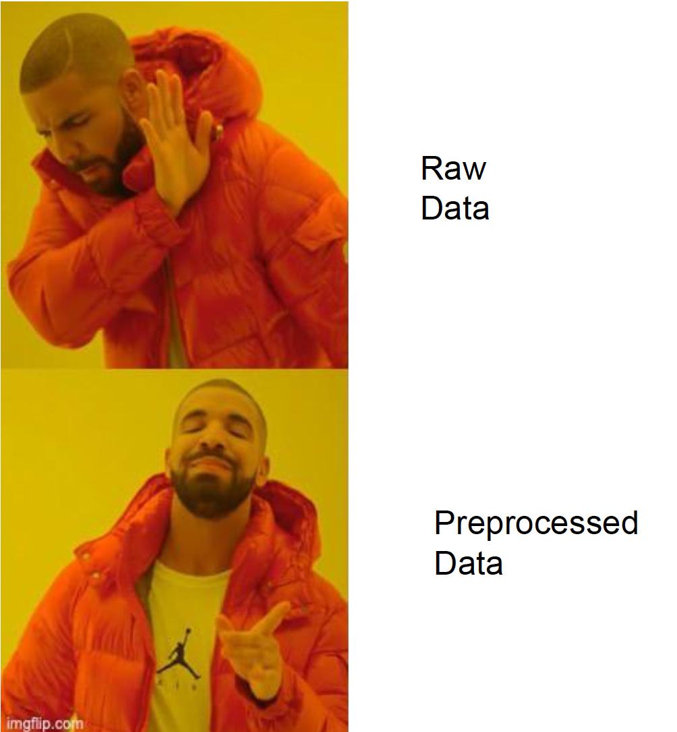
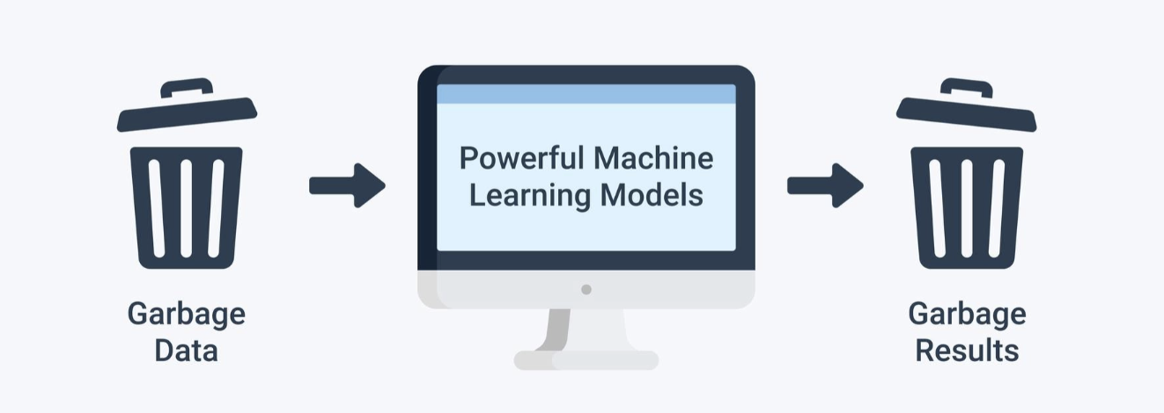
Introduction
Machine learning models learn a pattern from the data
Notes:
Why do we need data preprocessing? Machine learning models learn to find patterns from the data that they are trained on. For this, we need to provide datasets that our model can learn from. If we provide the models with some arbitrary random noisy data, which is the case in most datasets in raw form, we will get an arbitrary output as a result. In other words, garbage in - garbage out. Due to this, it’s important to have data that is consistent and standardized so that our machine learning models can learn to understand and interpret the input data to provide accurate predictions.
For example, if we want to train a machine learning model to predict the prices of a house based on the house’s size and location, the machine will find a pattern that indicates how these two attributes can influence the price of the house. In a more technical term, we can this fitting the model. Thus, how accurately the model can predict the price of a house is dependent on the data we have and the complexity of the model.

Slide 4
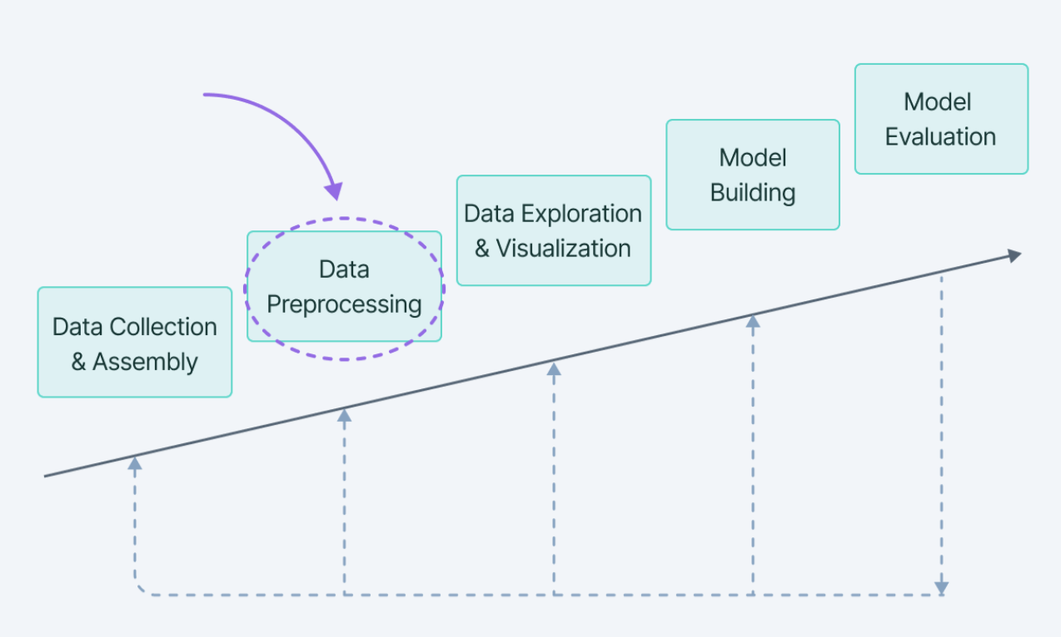
Data Preprocessing
Data preprocessing is a step in a machine learning pipeline that takes raw data as an input and transforms it to make it suitable for consequent steps such as train a model.
* Image source: link
Notes:
So data processing is the most step in a machine learning pipeline that takes raw data and transforms it into something useful for it to be used in other pipeline steps like fitting a machine learning model as discussed in the previous example.
As shown in the figure here, these are the most common steps in a machine learning pipeline. We start with data collection, preprocess our data accordingly, visualize if needed, build and fit the model, and finally evaluate our model.

Slide 5
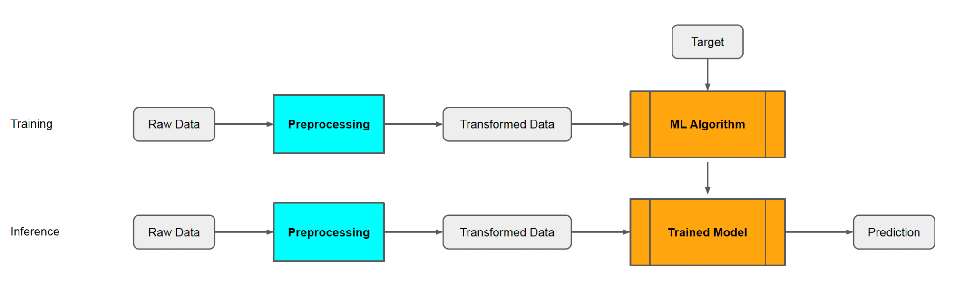
Preprocessing is applied before other processing steps, hence the name ‘pre-processing’
Notes:
Moving on, data preprocessing is the first step and comes before most steps, after data collection is done. Even though sometimes we might need to show and inspect the raw data, data preprocessing is the first basic step for future pipelines, including fitting our model.
For example, from the figure, we can see that after the raw data is collected, we preprocess the raw data and the result transformed data is fed into an ML algorithm.
One thing to notice is that our training and test or inference data should pass through the same preprocessing step to make sure we are using transformed data that has the same structure and standard. Since we want to make an inference on the same type of data on our trained model.

Slide 6
Splitting the dataset
It is always important to split your data into training and testing before any preprocessing.
Avoid data leakage!
Notes:
Another important thing we need to remember is that, before doing any preprocessing, we have to split our dataset into the train, test, and validation sets. This allows us to avoid data leakage that might be introduced into our validation and test sets. We will discuss more on this later.

Slide 7
Importance of Preprocessing
Notes:
We train on one set and evaluate how our model performs on a test set.

Slide 8
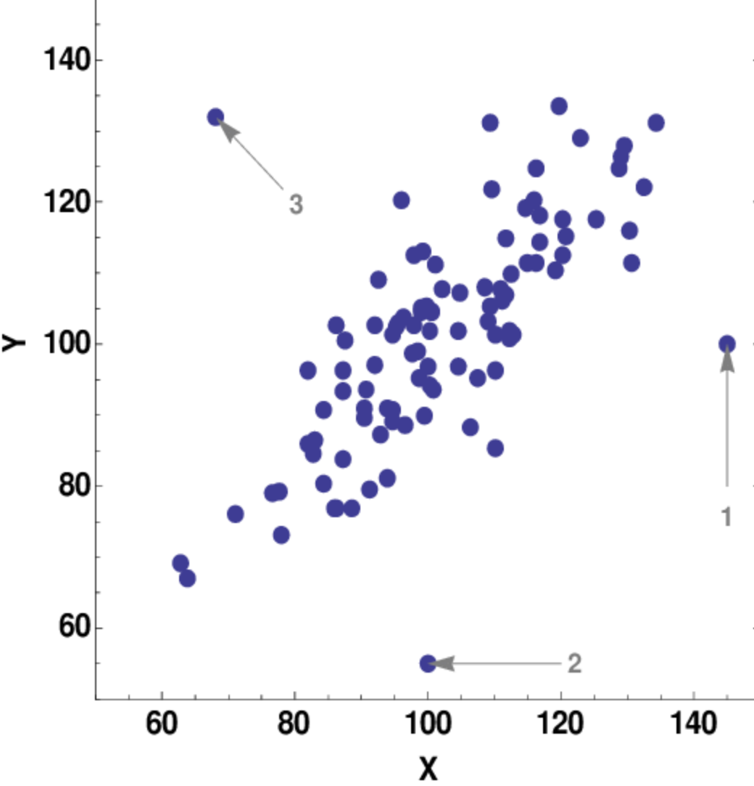
Importance of Preprocessing
Reasons for Preprocessing
Outlier samples
Uneven range of values
Redundant and unnecessary features
High dimensional data
Can’t be processed by machines (categorical)
Uneven distribution of classes
Incomplete rows
and more…
Notes:
Next, let’s discuss in detail why we preprocess data. And what happens if we don’t? There are various reseasons why data preprocessing is important in machine learning. Some of them are listed here and we will go through them in detail in the next slides including techniques to handle them.
But first, let’s talk about the figure. The figure shows a set of samples, X as an independent variable and Y as the dependent variable or target variable. As you can see from the figure, some of the values deviate from the general distribution of the data. These values are called outliers. Sometimes these outliers can have an effect on the performance of the model and due to this, it’s important to remove them from our dataset so that they don’t bias our machine learning model.

Slide 9
Data Cleaning
Uneven Range of Values: Some features might have values that are naturally very large, while others are naturally small. This might result in the former getting undue importance over the later
Scaling: Fit the data into a fixed scale, like 0-100 or 0-1
Normalization: Transform the data to have normal distribution
Data Type Mismatch: Data collected from different sources might have mismatched data types. Eg: Financial data with different currencies
Missing Data: Some features of the data might be missing
Imputing
Ignore the row
Cleaning Text & Speech: We might need to clean URLS, Stopwords (a, an, and, or, the,...), HTML tags, Emoji, “umm”, “err”, etc
Notes:
One of the main reasons for doing data preprocessing is to clean data. As we mentioned earlier, ML models will give us garbage if the input is garbage.
There are different reasons for cleaning data in the preprocessing stage. We will discuss some of them here.
First, we might have an uneven range of values. Some features might have naturally very large values, while others are naturally small. This results in the former getting undue importance over the later.
For example, for predicting the price of houses, we will have the area of the house and the year it was built. These two features have different value ranges and need to be transformed to make sure that the model is not biased by one of the features, since machine learning models are sensitive to the scale of the features.
To mitigate the issue, we can apply two common techniques. The first one is Scaling and the second one is Normalization.
Second, Some features of our data might have mismatched features. For example, financial data or house price prediction datasets might have values with different currencies, if the data is collected in different countries. Due to this, it’s important to handle data type mismatches.
Third, it is common to have some of the features of the data to have missing values. In this case, we can either impute or ignore the row with missing features. The second method is preferable if we have a large dataset.
In addition, other than those we discussed above, there are different data cleaning techniques depending on the type of the dataset. If we are working with text data, we need to clean URLs, and stopwords (such as a, an, the, or, and). And if we are working with speech data handling Ummm, err and cases similar to this are important.

Slide 10
High Dimensional Data
Problems with high dimensional data
Not all features are equally important
Multicollinear features
Noisy attributes
Data too large (in dimensionality)
Curse of dimensionality → generally sparse data points → model does not generalize well
Several Solutions
Feature correlation: Calculate correlation against target variable as a proxy for “importance” and remove features below some threshold
More next…
Notes:
Even though data with a lot of features is desirable, it also comes with its own problems. Some of them are listed here.
In order to handle the issues with high dimensional data, we can employ dimensionality reduction techniques such as feature correlation, which calculates the correlation between the target variable and the features to determine feature importance.
Generally, dimensionality reduction techniques can be grouped into two groups, as shown in the image.

Slide 11
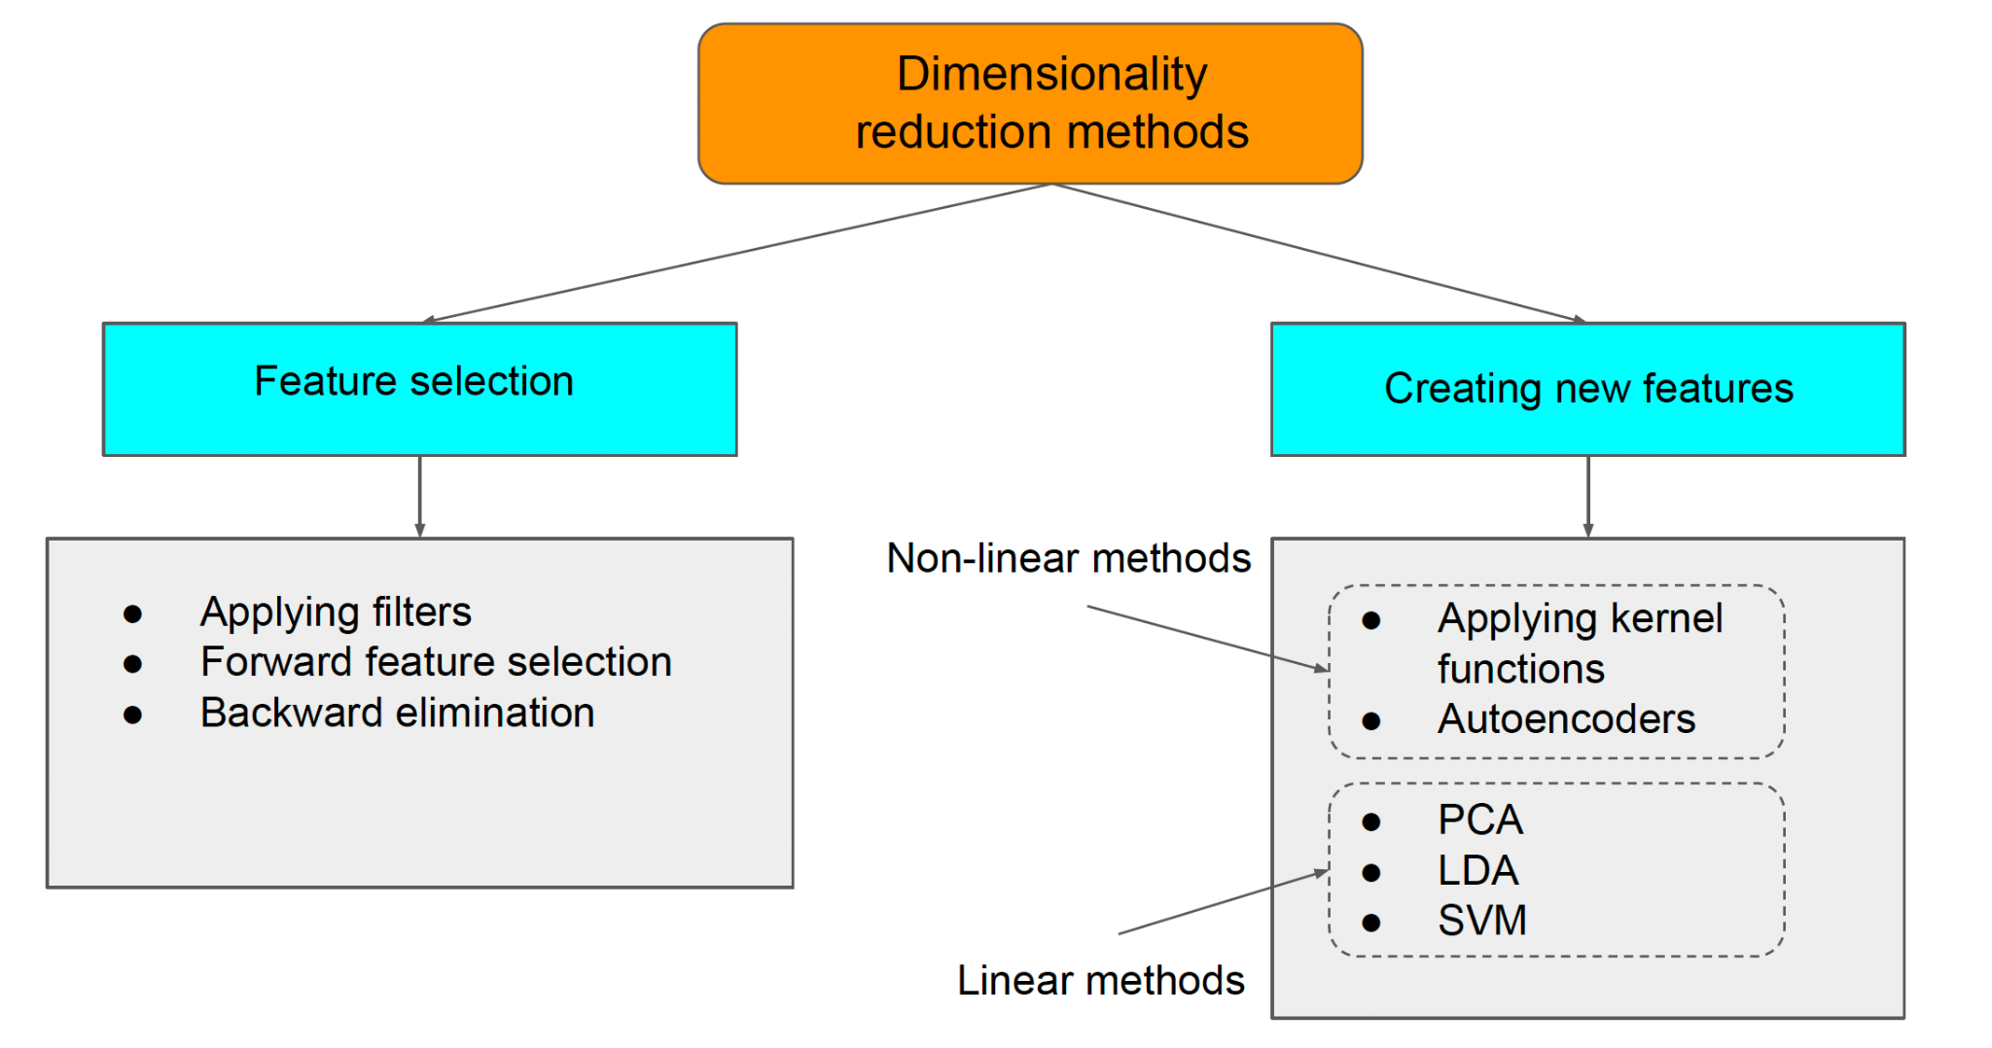
Dimensionality Reduction

Slide 12
Data Leakage
Data Leakage occurs when data that is not available during prediction is used for training.
Some input features are correlated with output or it has part of output while training which won’t be available during inference
Solutions
Remove features that contains information about the target that normally won’t be available during inference
Separate validation set to check model performance during training
K-Fold cross validation when data is less
Normalized training data separately and then use those parameters for test dataset
Notes:
Next, let's discuss data leakage. Data Leakage occurs when data that is not available during prediction is used for training. Some input features are correlated with output or it has part of output while training which won’t be available during inference.
For example, if we want to predict the visit time of a customer on an e-commerce site to improve the recommendation section, we don’t want to include visit history, since we might not have the data during actual inference time.
In order to prevent data leakage, we can use the following techniques. These are ways to check as well as prevent data leakage in our dataset.

Slide 13
Categorical Data
Machine can only interpret numerical values so mapping categorical data to numeric values before training is important
Methods
Mapping classes to unique numbers
(NOTE: might introduce undesired bias due to ordinality)
Create One Hot Encoded Vector
Use Feature Hashing → for large dataset or data encryption
Emotion classification: “emotion_happy” → [0, 0, 0, 1, 0, 0]
Notes:
One aspect of machine learning is converting categorical features into numerical values since machines and especially machine learning models need numerical data. Some of the methods that we can use to preprocess categorical data are mentioned here

Slide 14
Class Imbalance
Uneven distribution of classes (90 instances of class A and 10 instances of class B)
Method
Oversampling or Undersampling
Have realistic (sometimes uniform) distribution of classes over data
Weighted loss if data is highly imbalanced
Notes:
Class imbalance happens when there is an unequal distribution of target classes. This causes the model to have a poor generalization and becomes biased towards the class that has more examples.
Some of the solutions to handling class imbalance are mentioned here.
We use oversampling to generate synthetic samples for classes that have less number of instances. We can use duplication, SMOTE - creating synthesis sampling by interpolating existing samples and others.

Slide 15
Tools for Preprocessing

Slide 16
Tools for Preprocessing
Various python libraries support data preprocessing
PyTorch
Data Preprocessing
Random sampling, Weighted random sampling
Filters for cleaning data (example)
Random splitting and shuffling
Data Augmentation
Torchvision: Image
Torchaudio: Audio
Torchtext: Text
Used when implementing PyTorch Dataloader class
Scikit-learn, Pandas, NumPy
Random data splits, applying filters, normalizing features, etc
Notes:
Now that we have discussed some of the reasons why we preprocess data, next we will talk about some of the libraries that can be used.
PyTorch is the most popular framework for deep learning related tasks. It’s also the framework that we are going to use in this course. PyTorch has the following features for data preprocessing.
In addition, we can use the following extra libraries for augmentation while loading our data.
Other libraries include Scikit-learn, Pandas, and NumPy.

Slide 17
Preprocessing Speech Data

Slide 18
Signal Processing
Intro
Speech signals can be understood as a mixture of signals at various frequencies
Raw speech signals aren’t always the best source of data for models to work with
Contain noise
Naturally continuous data that needs discretization at the minimum
Reckless discretization can lead to noisy frequency bands
especially the high ones
Notes:
One of the areas where deep learning can be applied and as we will see in the course is speech. Speech signals can be understood as a mixture of signals at various frequencies. For models, raw speech signals aren’t always the best source of data to work with because they usually contain noise.
In addition, continuous data needs discretization at the minimum to be used in machine learning. Reckless discretization can lead to noisy frequency bands, especially the high ones.
MFCCs are used In order to extract features from a raw audio signal. Next, we will discuss in detail the term, and the steps to extracting MFCCs. We will also go over a code to show you how we can get MFCCs.
The term MFCC is composed of three terms, Mel Frequency, Cepstral, and Coefficients.
As shown in the figure, the steps to extract MFCCs from the raw signal can be generally divided into 3 stages. Next, we will go through each stage.

Slide 19
Mel-Frequency Cepstral Coefficients (MFCCs)
MFCC
Mel Frequency Cepstral Coefficients

Slide 20
MFCC
Mel Frequency Cepstral Coefficients

Slide 21
MFCC
Mel Frequency Cepstral Coefficients

Slide 22
MFCC
Mel Frequency Cepstral Coefficients
Cepstrum ↔ Spectrum
C(x(t)) = F⁻¹[log(F[x(t)])]

Slide 23
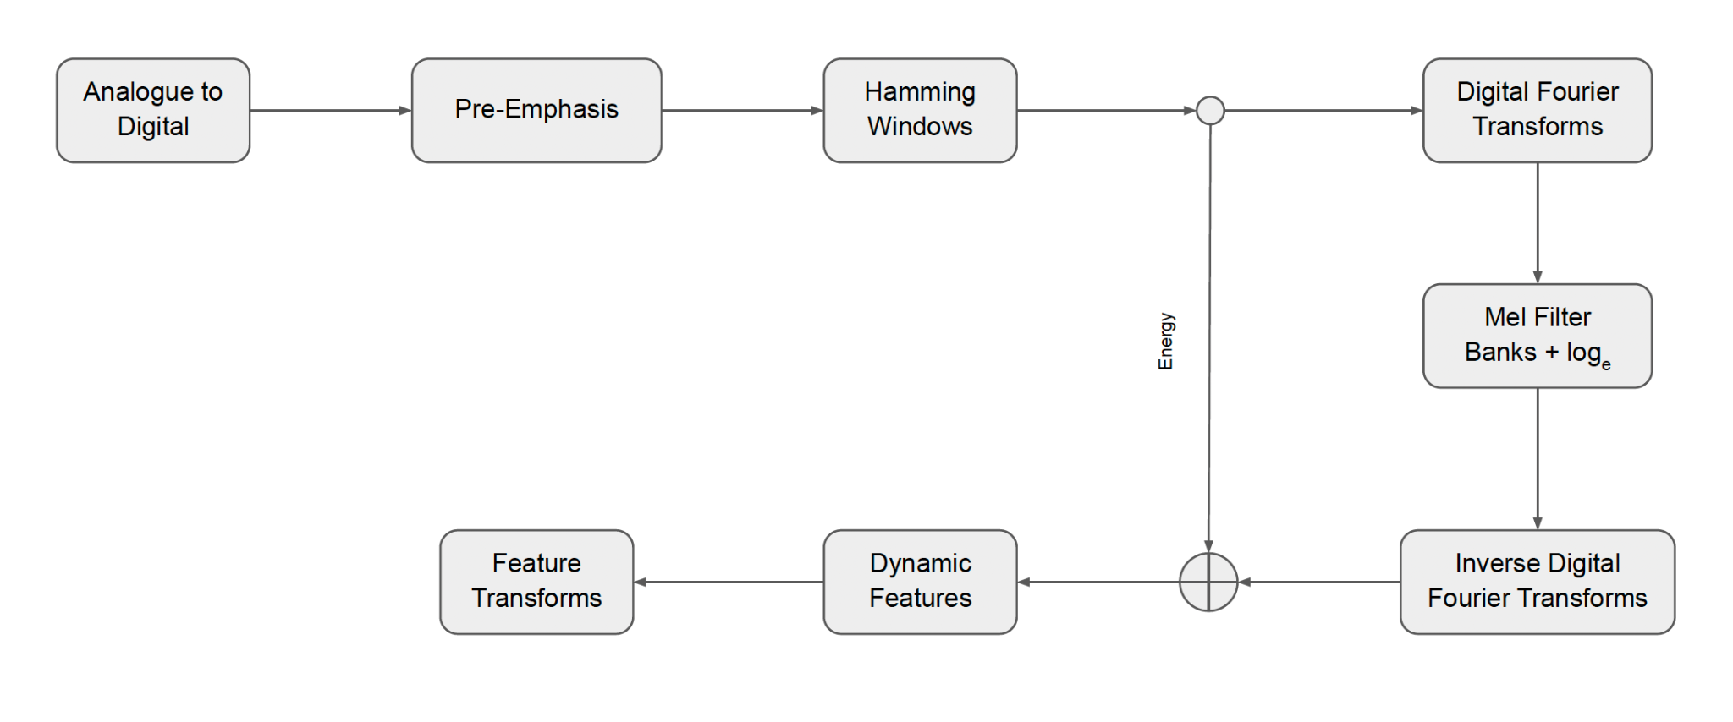
Generating MFCCs

Slide 24
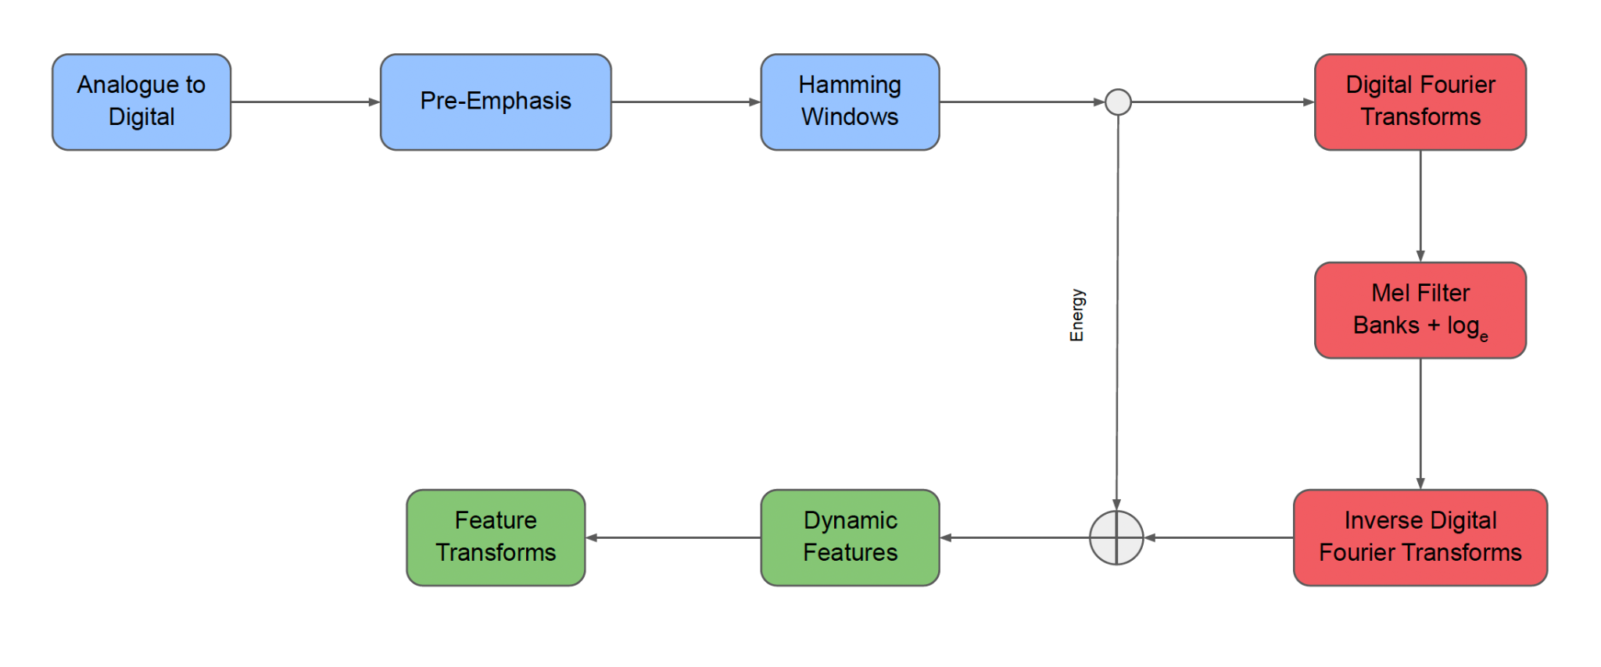
Generating MFCCs

Slide 25
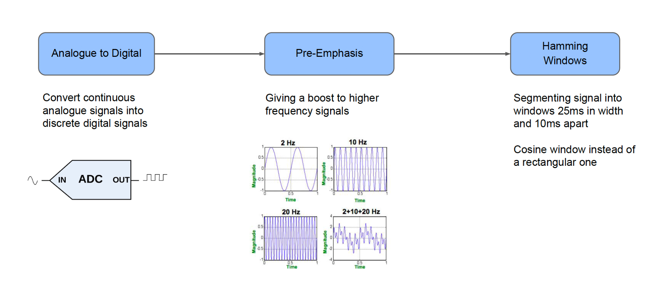
Stage 1

Slide 26
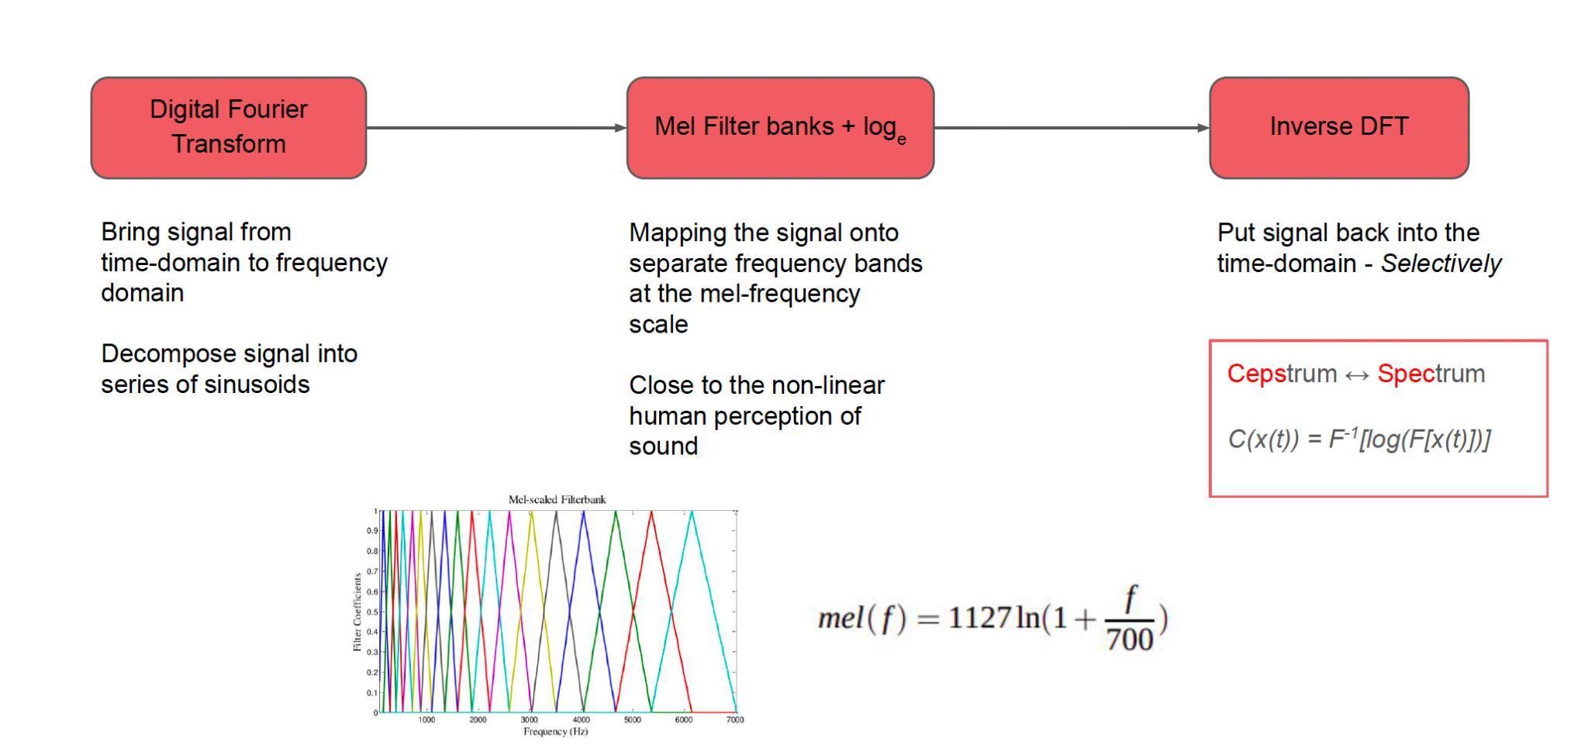
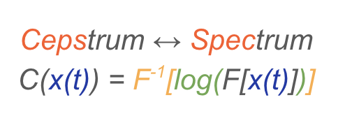
Stage 2

Slide 27
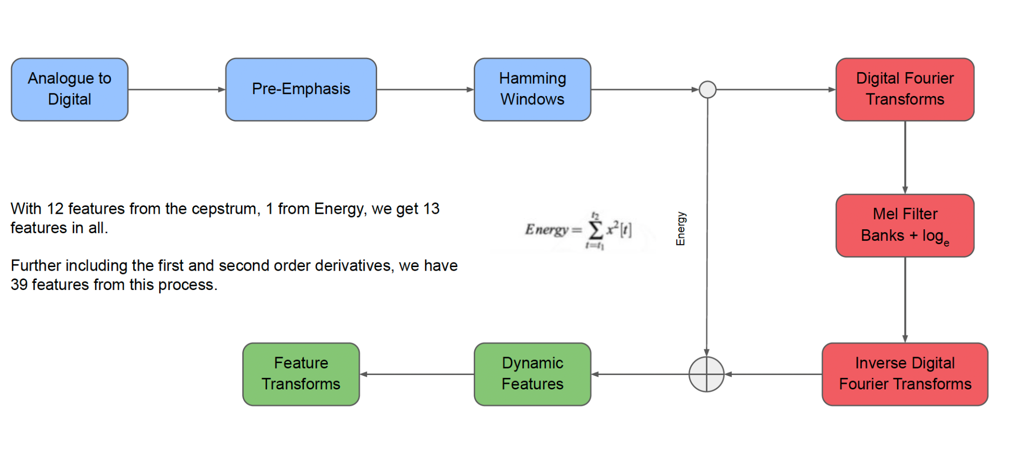
Stage 3 and Energy

Slide 28
Code Example
Extracting MFCCs
https://colab.research.google.com/drive/18xpc-ox_AXAEXq2B_Lvh4d3CbmNb6oph?usp=sharing

Slide 29
References
https://www.investopedia.com/terms/m/multicollinearity.asp
https://haythamfayek.com/2016/04/21/speech-processing-for-machine-learning.html
https://www.maskaravivek.com/post/pytorch-dataloader-with-corrupted-data/
https://pytorch.org/docs/stable/data.html

